Slide 1



Introduction to JavaScript Concepts
Author: Madiha Ayaz
Created with Pi

Slide 2

CONTENTS
1. Loops
2. Script Placement
3. Commenting in Code
4. Events
5. Reading and Setting Field Values
6. Text and Image Manipulation
7. Swapping Images
8. Styling
9. DOM Manipulation

Slide 3


Slide:1 Suhaira
1. Loops
While Loops
What is a While Loop? A while loop repeatedly executes a block of code as long as a specified condition is true.
Syntax:
}
count++;
console.log("Count is: " + count);
while (count <= 5) {
let count = 1;
// Example: Counting from 1 to 5
while (condition) { // code to be executed }
Key Point
The condition is checked before each iteration. If the condition is initially false, the loop's code block will never run.

Slide 4
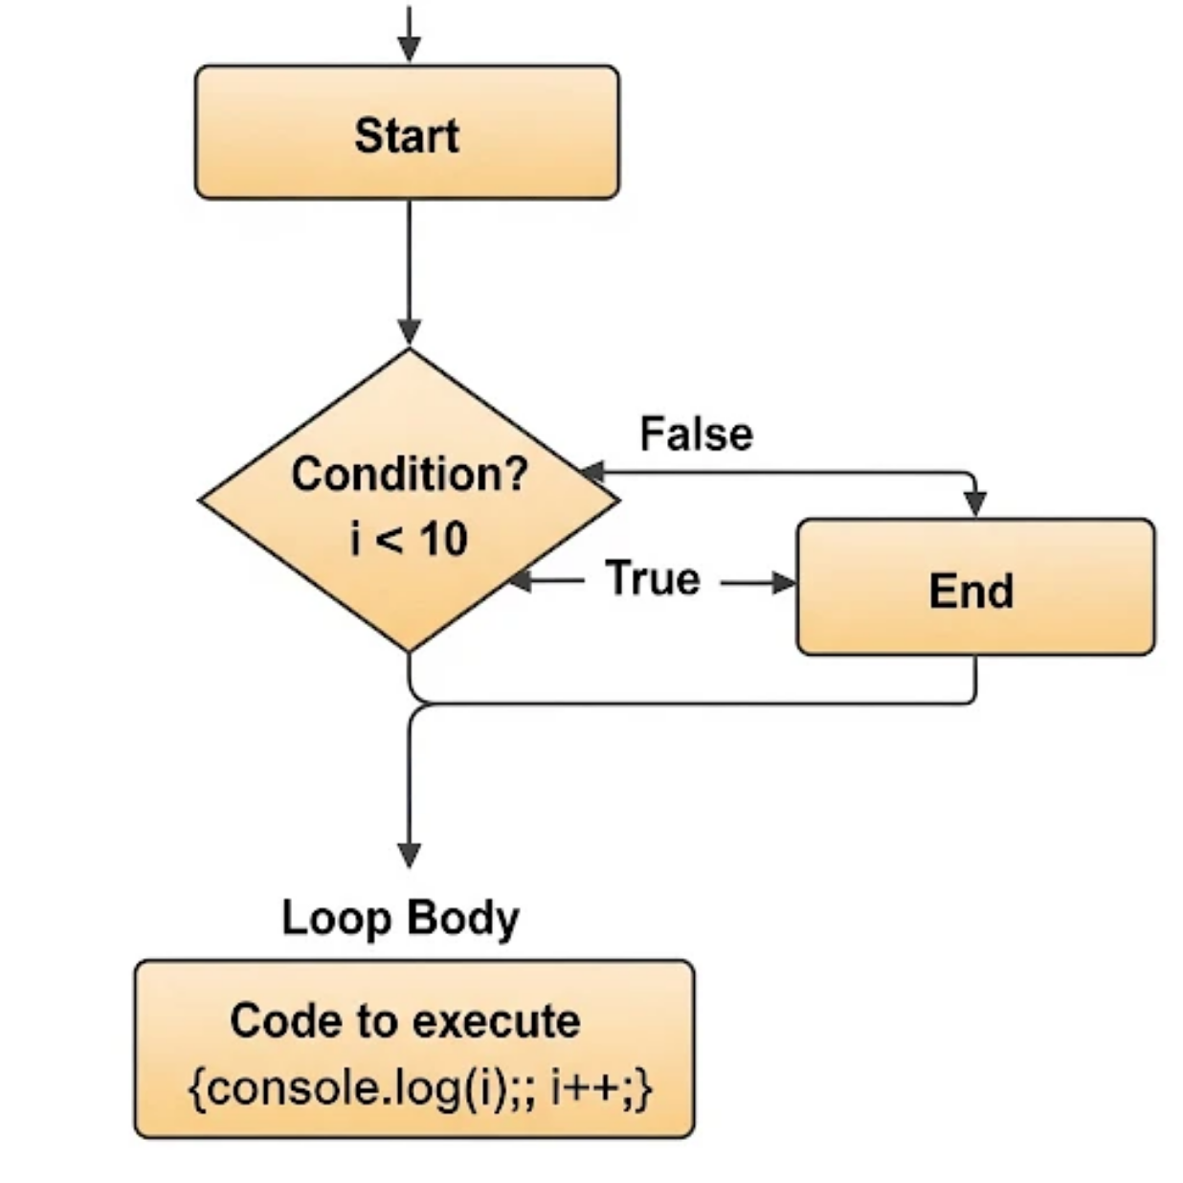
illustrating the structure of a JavaScript while loop.
A while loop checks a condition first.
If the condition is true, it runs a block of code (the loop body)
After the code runs, it checks the condition again
This process repeats until the condition becomes false.
Once the condition is false,
the loop ends.

Slide 5


Do...While Loops
1
What is a Do...While Loop? A do...while loop is similar to a while loop, but it guarantees that the code block will execute at least once.
2
Syntax:
} while (count <= 5);
count++;
console.log("Count is: " + count);
do {
let count = 1;
// Example: Counting from 1 to 5
do { // code to be executed } while (condition);
Key Point
The code block runs first, and the condition is checked after each iteration.

Slide 6



2. Script Placement
Placing Scripts
</body>
</script>
document.body.style.backgroundColor = "lightyellow";
console.log("JavaScript is running after HTML is loaded!");
<script>
<!-- Script placed at the end -->
<p>This text will load before the script runs.</p>
<h1>Hello World!</h1>
<body>
Option 2: At the end of the section
Why place the script here?
The HTML is fully loaded before the JavaScript runs.
No delay in showing the page’s content.
Simple and effective for most small scripts.

Slide 7


3. Commenting in Code
Commenting
Clarity
Types of Comments
Comments explain what your code does, making it easier for you and others to understand.
• Single-line Comment: Starts with //
• Multi-line Comment: Starts with /* and ends with */

Slide 8

Slide:2 Alishba
4. Events
Events: Link
User interaction with links. Example:
</body>
</script>
});
alert("You clicked the link!");
event.preventDefault(); // Prevents the link from navigating
document.getElementById("myLink").addEventListener("click", function(event) {
<script>
<a href="#" id="myLink">Click Me</a>
<!-- Link that triggers an event -->
<body>
Click Me

Slide 9

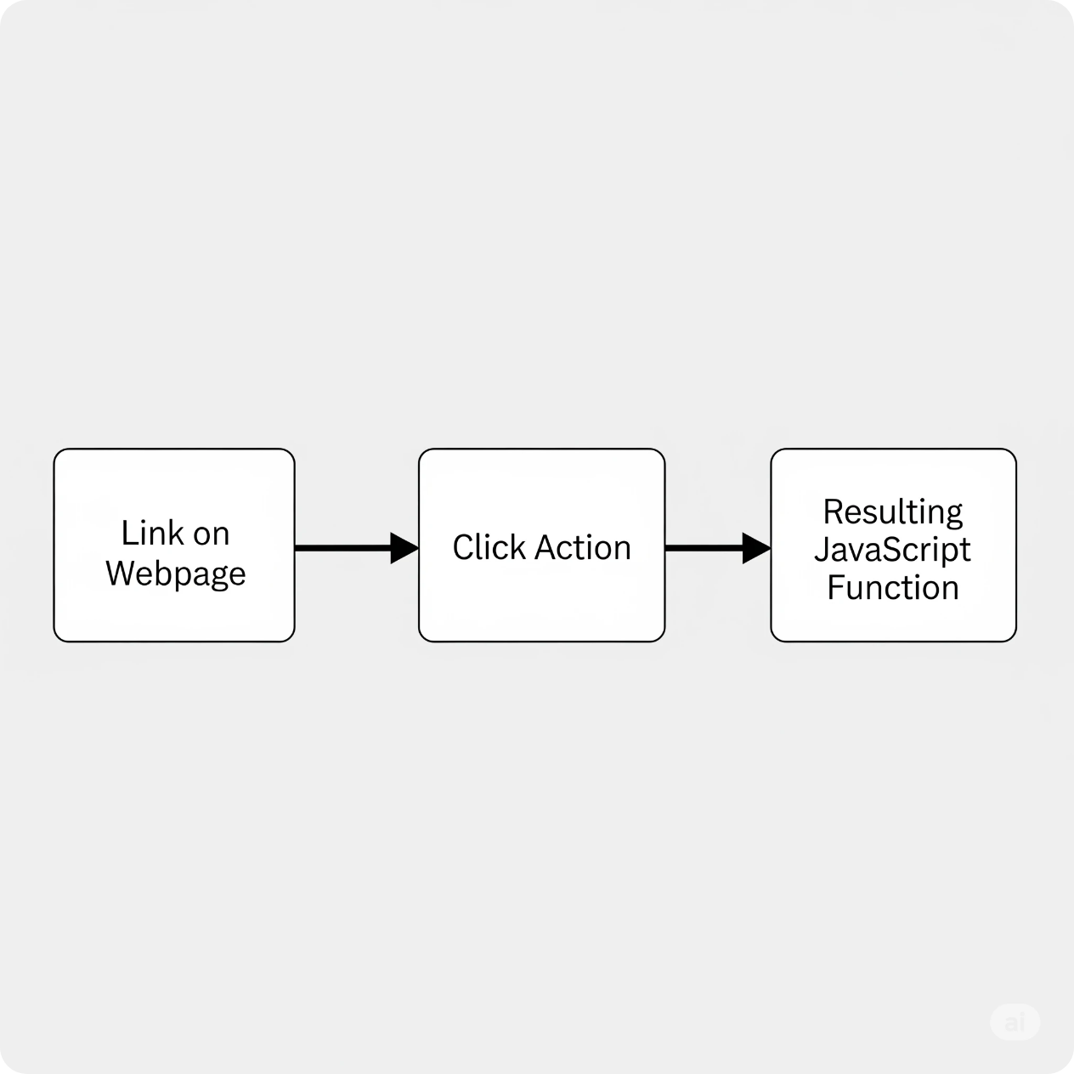
Here is a diagram that explains how JavaScript events work with a link.
When you click on a link, an event happens. You can tell JavaScript to listen for that specific event and run a function instead of going to a new page.

Slide 10

Events: Button
1
User interaction with buttons.
2
Example:
</script>
});
alert("Button was clicked!");
document.getElementById("myButton").addEventListener("click", function() {
<script>
Event listeners for a button wait for a specific action, like a click. When the action happens, the listener runs a function you've defined, which allows you to perform an action.
Click Me

Slide 11


Events: Mouse
Common mouse events onmouseover (mouse enters), onmouseout (mouse leaves).
<div onmouseover="this.style.color='red'">Hover over me</div>

Slide 12

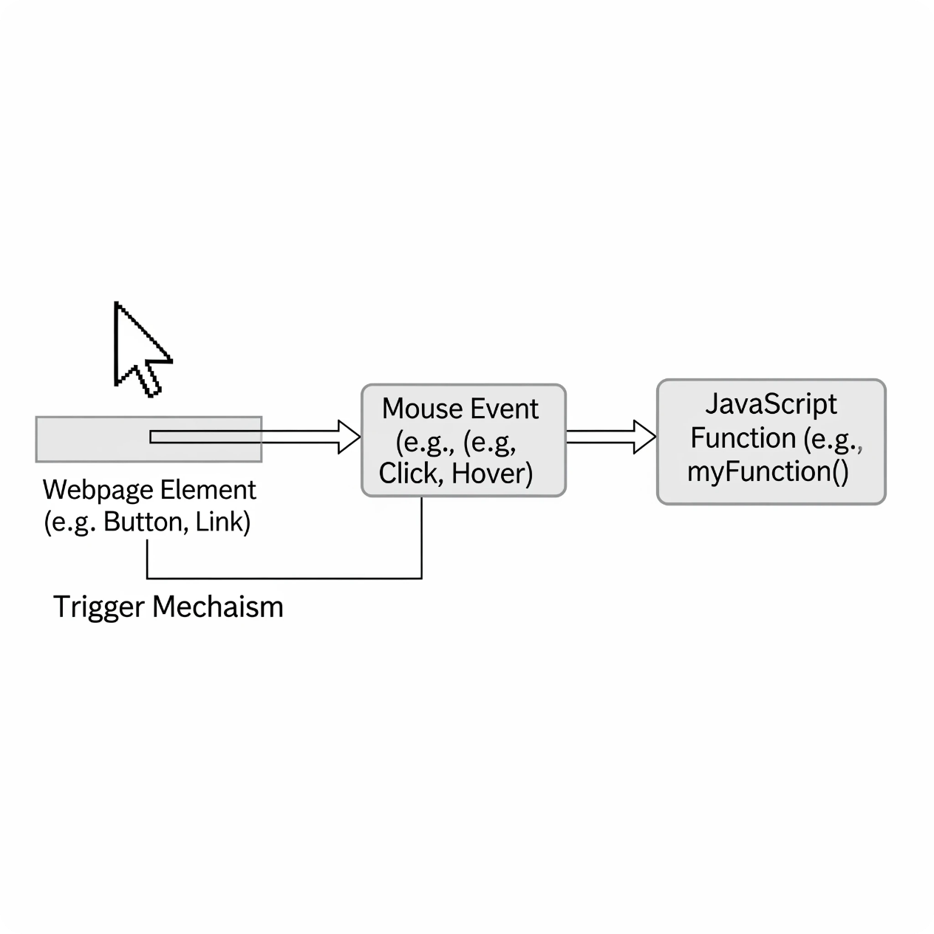
Here is a simple diagram that shows how mouse events work with JavaScript.
1
2
Event listeners are like watchers for elements on a webpage. When a user interacts with an element (like a button or link) in a certain way, the event listener detects that action and then runs a specific function. This is how you make a webpage interactive.

Slide 13




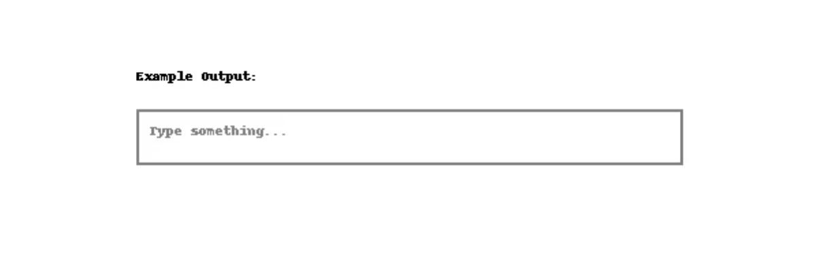
Slide:3 Mahenoor
Events: Fields
Concept: Handling events that occur within input fields.
Common Events:
onfocus: When the field is selected.
onblur: When the field is deselected.
onchange: When the value is changed and the field is deselected.
Visual Suggestion: An input field with a border changing color when focused.
Form inputs and user data. OUTPUT
<input type="text"
onfocus="this.style.border='2px solid green'"
onblur="this.style.border='1px solid gray'"
onchange="alert('Value changed!')"
placeholder="Type something..." />

Slide 15




5. Reading and Setting Field Values
Reading Field Values
Setting Field Values
• The .value Property: This is the most common way to get the content of an input field.
• You can assign a new value to the .value property.
//html
<input type="text" id="usernameInput" value="JohnDoe">
//javascript code
// Get the input element by its ID
const usernameField = document.getElementById("usernameInput");
// Read the value of the input field
const username = usernameField.value;
console.log(username); // Output: "JohnDoe"

Slide 16

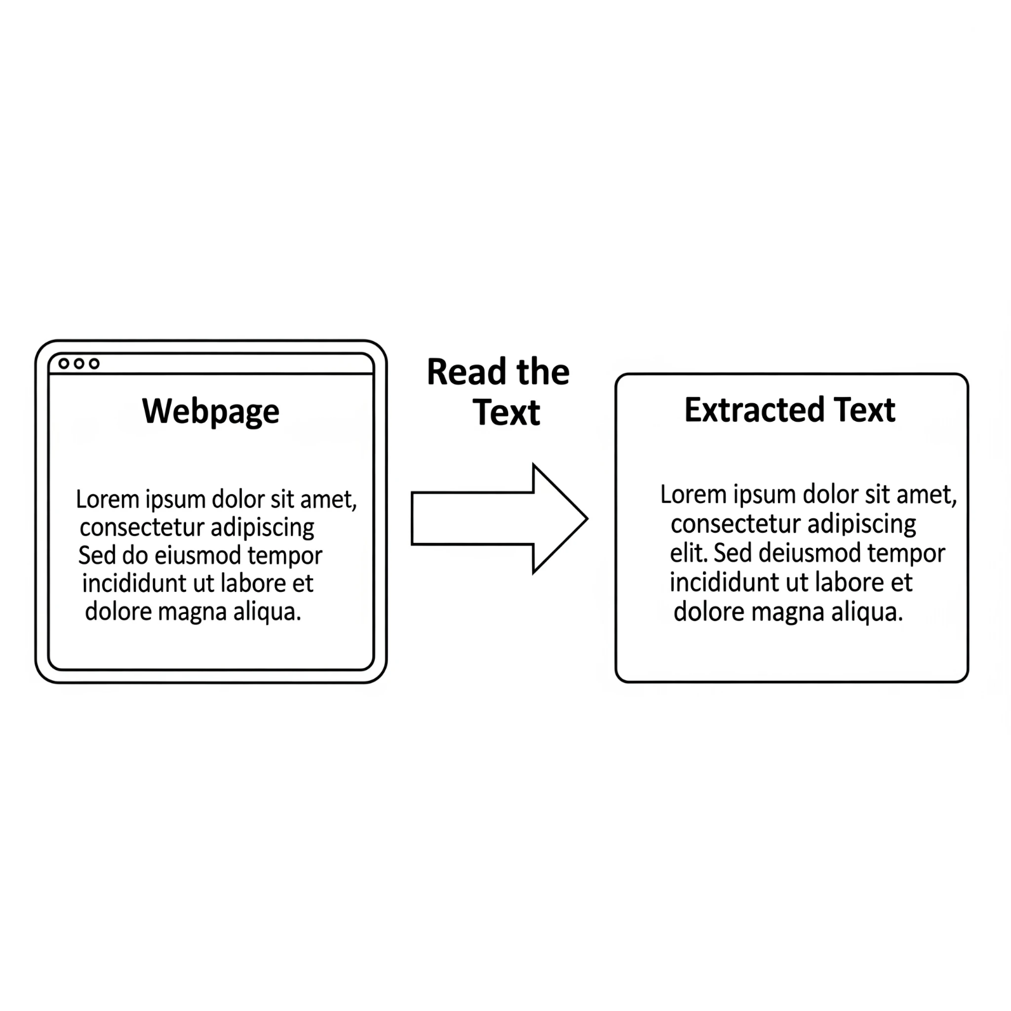
Slide:4 Sadaf
Reading Paragraph Text
// Get the paragraph element with the ID "myParagraph"
const myParagraph = document.getElementById('myParagraph');
// Read the text content
const paragraphText = myParagraph.textContent;
// Log the text to the console
console.log(paragraphText);

Slide 17


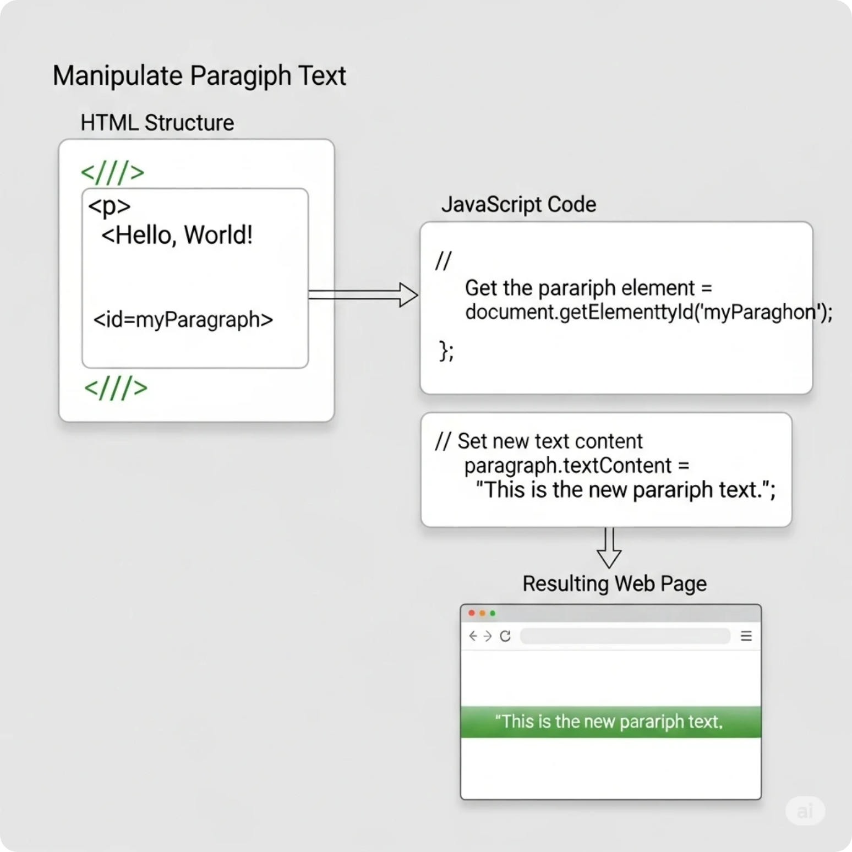
Setting Paragraph Text
.textContent property.
const myParagraph = document.getElementById('myParagraph');
// Set new text for the paragraph
myParagraph.textContent = 'This is the new paragraph text.';

Slide 18


6. Text and Image Manipulation
1
Reading and Setting Paragraph Text
2
Manipulating Images and Text
• Use .textContent for safe text manipulation.
• Changing an image's source: Use the .src property.
<p id="myParagraph">This is the original text.</p>
/ Get the paragraph element //javascript
const myParagraph = document.getElementById("myParagraph");
// Read the text content
const currentText = myParagraph.textContent;
console.log(currentText); // Output: "This is the original text."
// Set new text content
myParagraph.textContent = "This is the new text.";

Slide 19


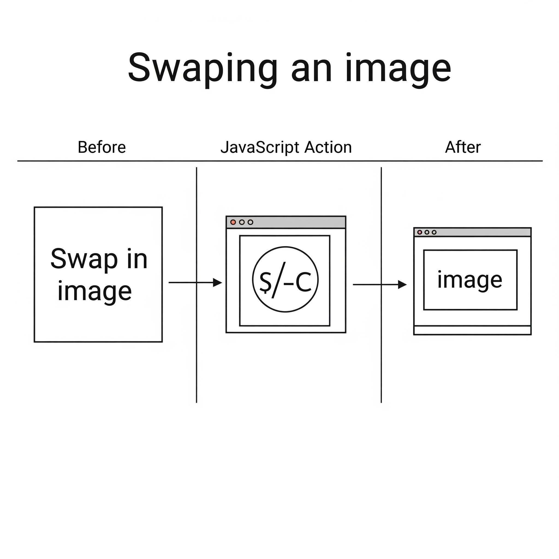

Slide:5 Madiha
7. Swapping Images
Swapping Images
• Basic image swap: Change the .src attribute.
• Example:
<button onclick="swapImage()">Swap Image</button> //html
function swapImage() {
const imageElement = document.getElementById("myImage");
// Change the image source to a new file
imageElement.src = "images/pic2.jpg";
}

Slide 20
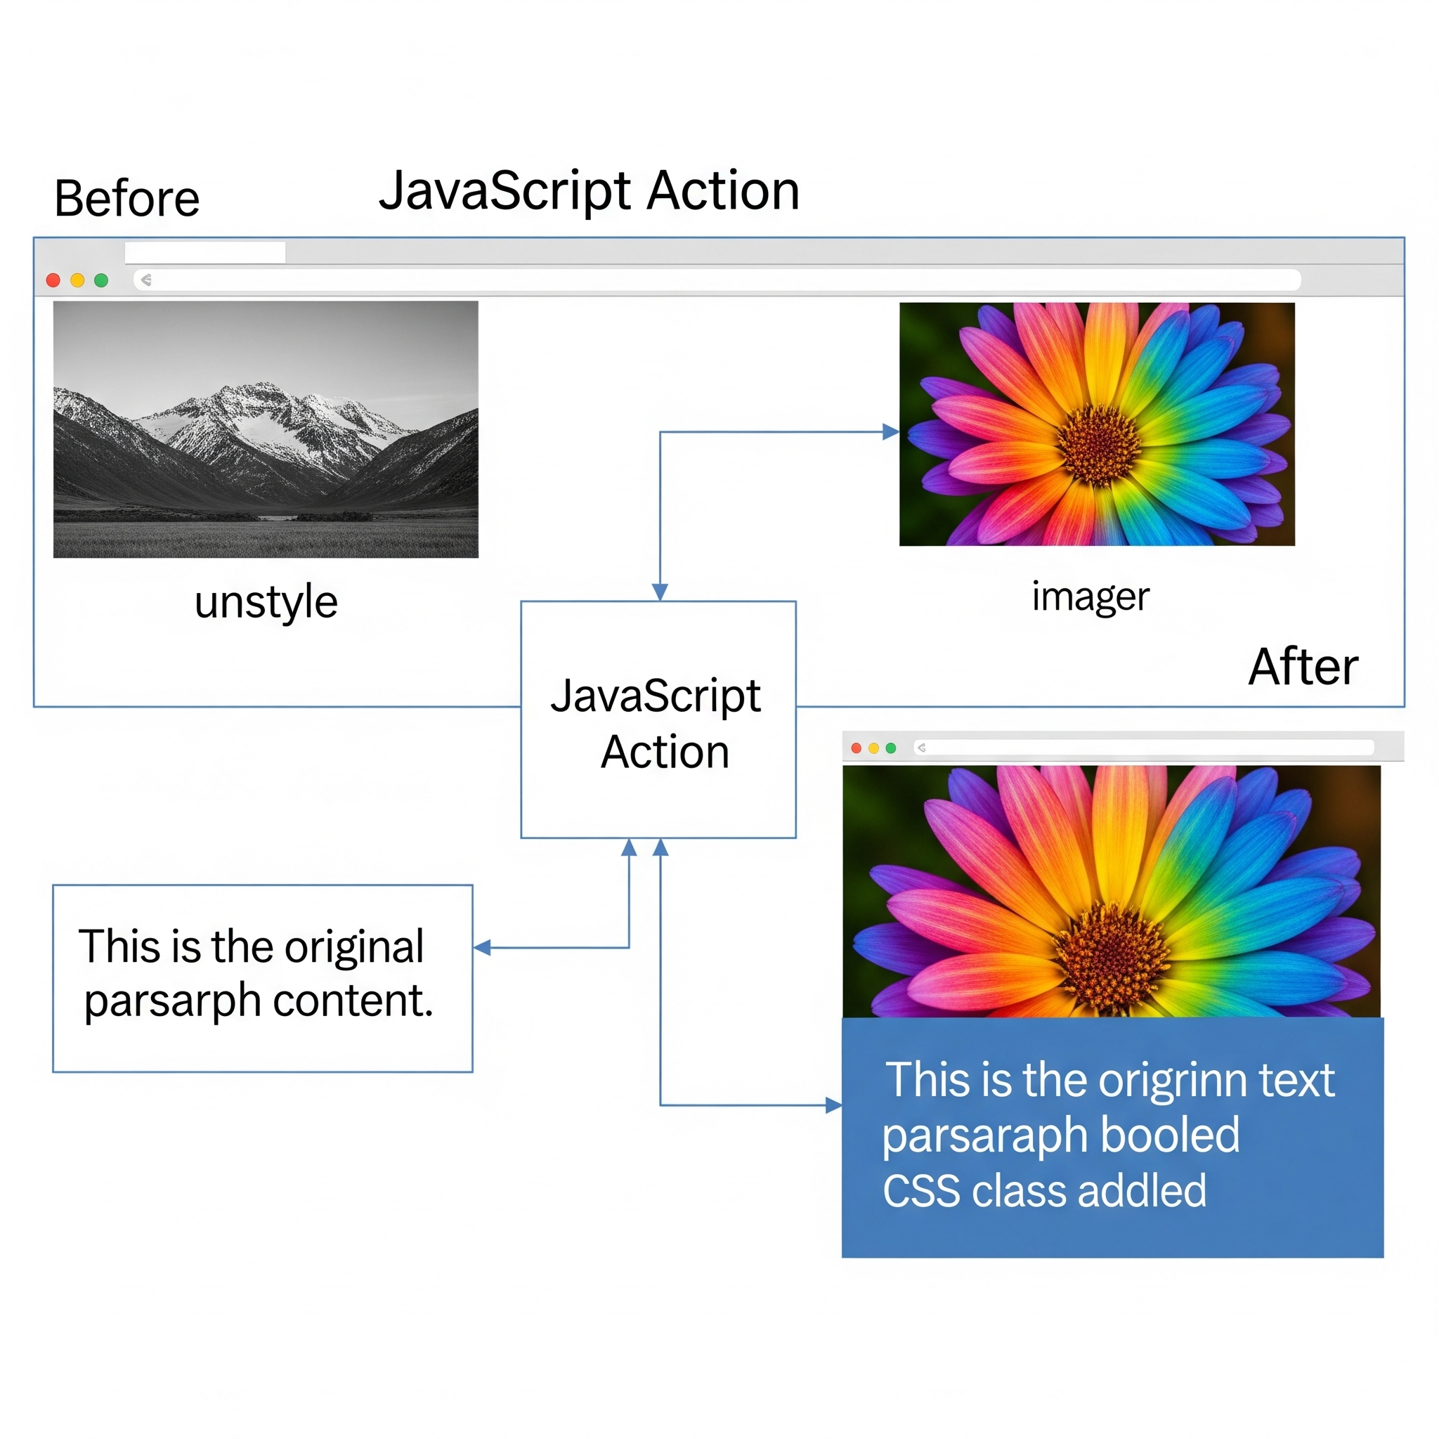
2. Swapping Images and Setting Classes
This involves both changing the image and applying a new CSS class to a different element on the page. By adding or removing a class, you can instantly apply a set of predefined styles (like color, font size, or background) to an element.
// Get the image and text elements
const myImage = document.getElementById('myImage');
const myText = document.getElementById('myText');
// Swap the image
myImage.src = 'new-image.jpg';
// Add a CSS class named 'highlight' to the text
myText.classList.add('highlight');

Slide 21

Slide:6 Liaba
9. DOM Manipulation
The DOM
// This will get all <p> elements on the page
const allParagraphs = document.getElementsByTagName('p');
// You can loop through them like an array
for (let i = 0; i < allParagraphs.length; i++) {
// Change the text of each paragraph
allParagraphs[i].textContent = "I am a paragraph!";
}
• DOM stands for Document Object Model. It represents the page so that programs can change the document structure, style, and content.
Target All Elements by Tag Name
•The getElementsByTagName() method returns a collection of all elements with a specified tag name (e.g., <p>, <h1>, <div>). This method returns a live HTMLCollection, which can be treated like an arrays
.
•

Slide 22
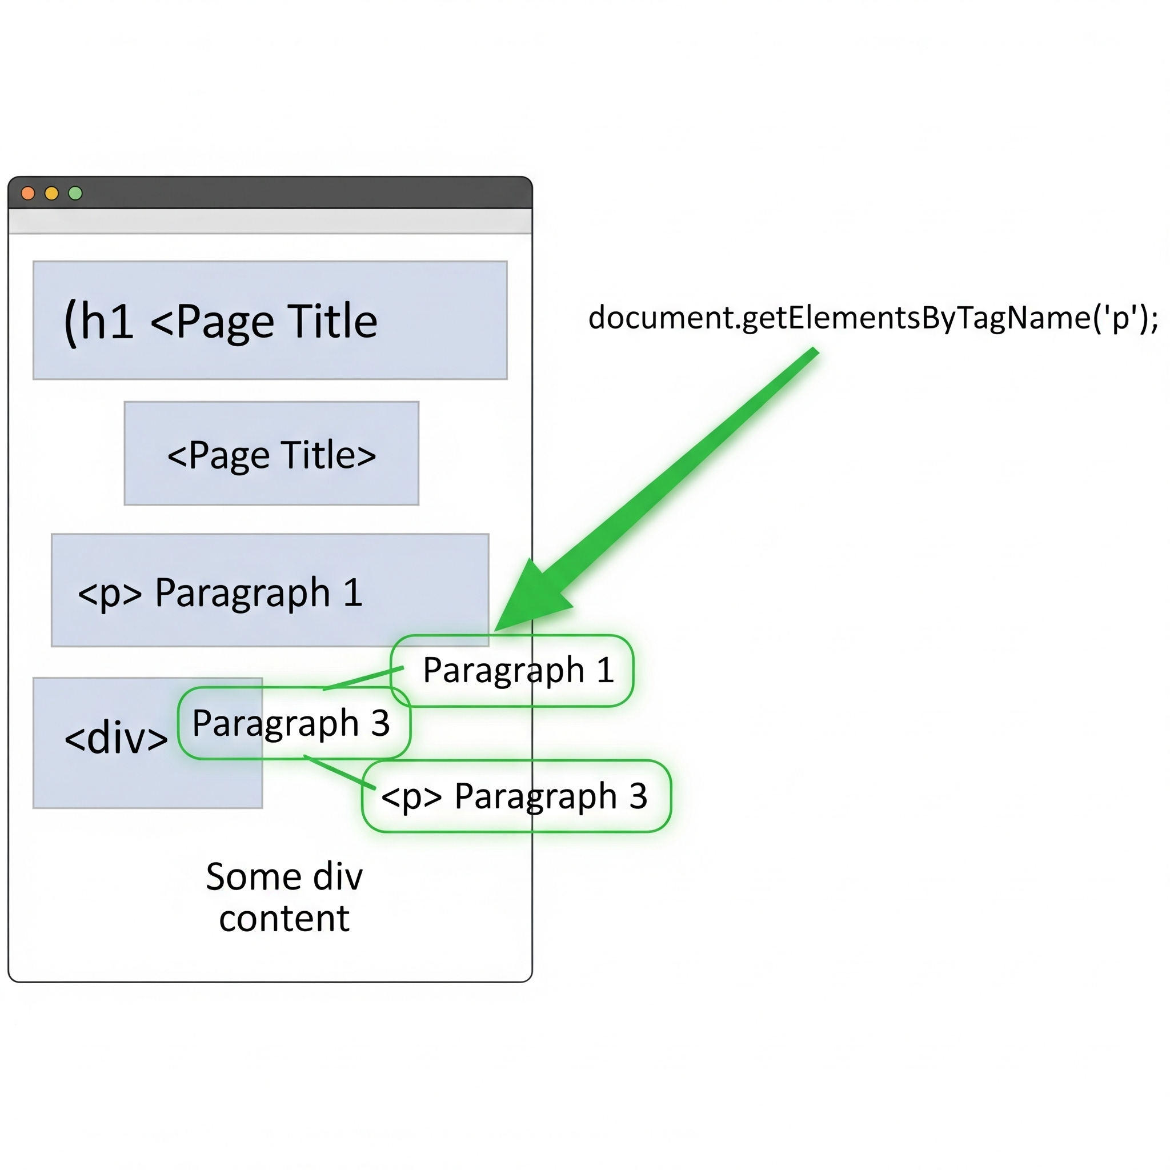
2. Target Some Elements by Tag Name
A more modern and flexible way to select elements is using querySelectorAll(). This method returns a NodeList of all elements that match a specified CSS selector. You can still loop through this list like an array.
Code:
// Get all <div> elements on the page
const allDivs = document.querySelectorAll('div');
// Get all elements with the class 'important'
const importantElements = document.querySelectorAll('.important');
// Get all <a> tags (links) that are inside an element with the ID 'navigation'
const navLinks = document.querySelectorAll('#navigation a');

Slide 23


Here’s a clear, structured example covering all the points you mentioned for DOM Manipulation:
<body>
// Target all elements by tag name
<div id="container">
document.getElementById("tagButton").addEventListener("click", function() {
<h2 class="title">First Title</h2>
<h2 class="title">Second Title</h2>
let headings = document.getElementsByTagName("h2");
<p>This is a paragraph.</p>
</div>
for (let i = 0; i < headings.length; i++) {
<button id="tagButton">Target by Tag Name</button>
headings[i].style.color = "blue";
}
<button id="classButton">Target by Class Name</button>
});
<button id="childButton">Find Children</button>
// Target some elements by class name
document.getElementById("classButton").addEventListener("click", function() {
<script src="script.js"></script>
let titles = document.getElementsByClassName("title");
</body>
</html>
for (let i = 0; i < titles.length; i++) {
titles[i].style.backgroundColor = "yellow";
}
});
// Finding children of a parent element
document.getElementById("childButton").addEventListener("click", function() {
let container = document.getElementById("container");
let children = container.children;
for (let i = 0; i < children.length; i++) {
children[i].style.border = "1px solid red";
}
});

Slide 24
Slide 7 Rida
The DOM: Parents and Children
<div id="parent-div">
<p id="child-p1">This is the first child.</p>
<p id="child-p2">This is the second child.</p>
</div>
The DOM (Document Object Model) is a tree-like representation of a web page. Parents and children refers to the hierarchical relationship between the elements in this tree.
A parent is an element that contains other elements.
A child is an element that is directly inside another element.
In JavaScript, you can use properties like parentNode, children, firstElementChild, and lastElementChild to navigate this structure
// Get a reference to a child element
const childElement = document.getElementById('child-p1');
// Use parentNode to get the parent element
const parentElement = childElement.parentNode;
console.log(parentElement.id);
// Output: "parent-container"
// This code defines "parentElement" as the parent of "childElement"."

Slide 25
2. Defining Children
You can define a collection of child elements from a parent using the children property. This returns an HTMLCollection of all the direct child elements.
// Get a reference to the parent element
const parentElement = document.getElementById('parent-container');
// Use children to get all direct child elements
const childrenCollection = parentElement.children;
console.log(childrenCollection.length);
// Output: 2
console.log(childrenCollection[0].id);
// Output: "child-p1"
// This code defines "childrenCollection" as the children of "parentElement".

Slide 26
Finding children
<ul id="my-list">
<li>Item 1</li>
<li>Item 2</li>
<li>Item 3</li>
</ul>
children: This property returns an array-like list of all a parent's direct child elements. You can access individual children using an index.
const parent = document.getElementById('my-list');
const allChildren = parent.children;
console.log(allChildren.length); // 3
console.log(allChildren[0].textContent); // "Item 1"
console.log(allChildren[2].textContent); // "Item 3"
firstElementChild: This property returns only the very first child element.
lastElementChild: This property returns only the very last child element.
const parent = document.getElementById('my-list');
const firstChild = parent.firstElementChild;
console.log(firstChild.textContent); // "Item 1"
const parent = document.getElementById('my-list');
const lastChild = parent.lastElementChild;
console.log(lastChild.textContent); // "Item 3"

Slide 27

Thank You
Thank you so much for being such a great teacher. I've really learned a lot from you

